Slide 1

Bein-Sport
Scientific Computing
Faculty of Computer and Information Science
Ain Shams University

Slide 2
Team members
Bola Milad Shokry
Ahmed Magdy Ahmed
Tasneem Bahaa Eldin
Bassant Salem Mahmoud
Jonathan Mamdouh Monir
Shaimaa Hesham Abdelmoneem

Slide 3
Dr. Manal Tantawi TA. Aya Nasser
Supervisors

Slide 4
Table of contents
01
02
04
Introduction
06
Conclusion & future work
Dataset Description
03
System Architecture
Experiments
& Results
05
Demo

Slide 5
01
Introduction

Slide 6
Problem Definition

Slide 7
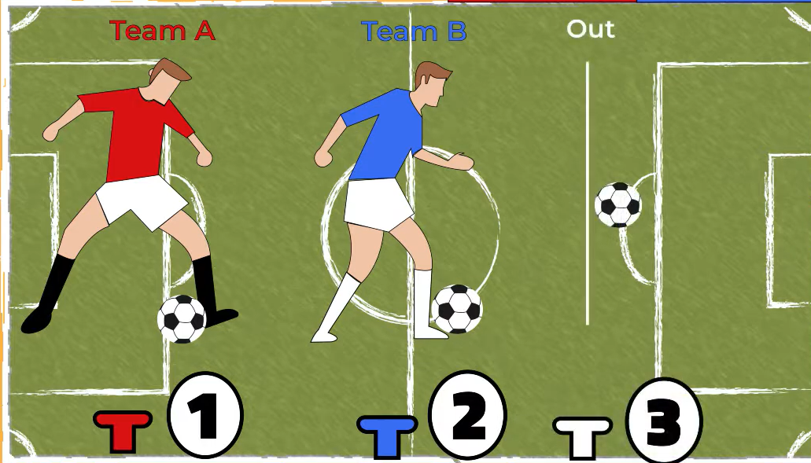
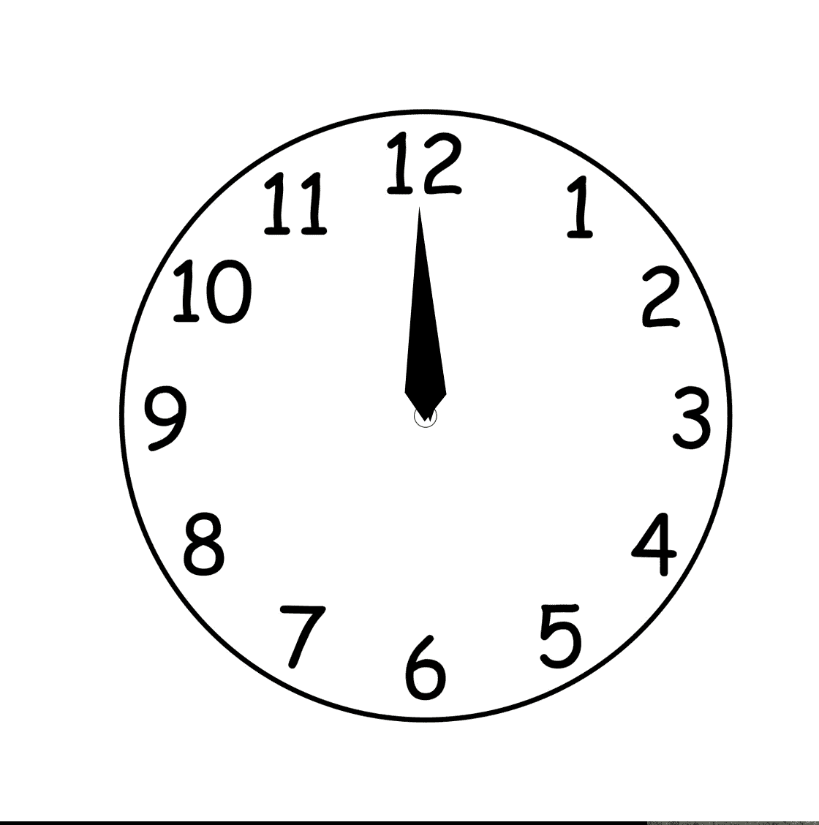
Traditional ball possession analysis in football relies on manual methods, which are prone to inaccuracies.
Methods involve manually timing possession or counting passes, leading to errors, particularly in high-paced games or during contested ball control..

Slide 8
Motivation

Slide 9
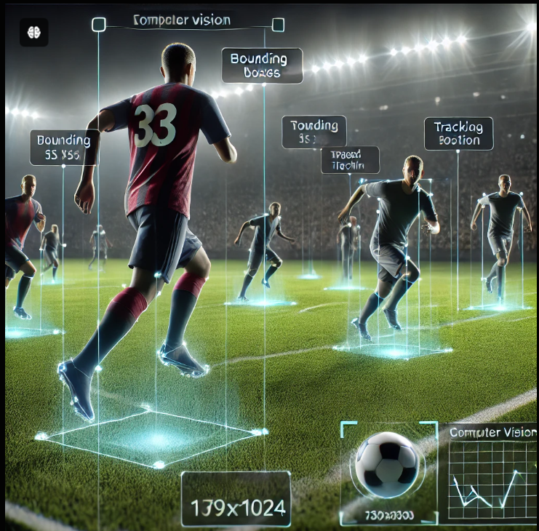
Current methods for measuring ball possession lack precision, especially for teams with unique play styles. Analysts need automated solutions to minimize errors and capture subtle game dynamics. Computer vision and deep learning offer a revolutionary approach—providing objective, consistent insights into possession

Slide 10
Objectives
There is a need for a more accurate, objective system to assess ball possession

Slide 11
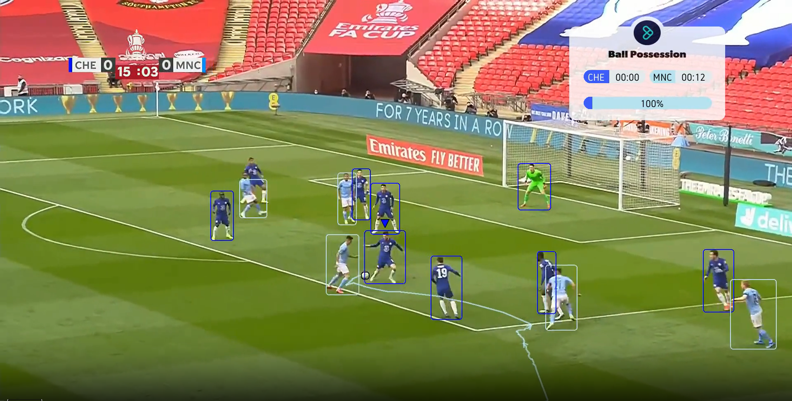
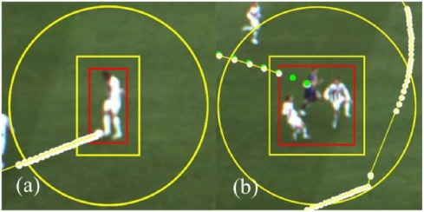
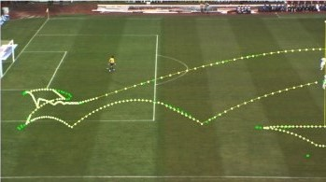
Our Primary Objective is to design an application that processes
real-time football footage to
provide accurate possession metrics
Detect players
track the ball

Slide 12
Related work
Explore existing solutions in sports analytics, focusing on computer vision and deep learning applications in football analysis

Slide 13
Detection
Papers [1] (2024) [2] (2022) [3] (2024) | Dataset ISSIA Dataset Live football matches: FC Barcelona vs. Real Madrid (2015) Chelsea vs. Manchester City (2020). Custom dataset Soccer Net UHDSR8K | . Methods YOLO v4 Geometric Midpoint (GM) approximation. Weighted Intersect Fusion (WIF) Background extraction Color difference models Faster R-CNN Super-Resolution Network | Accuracy Accuracy: 96.5% Precision: 96% Recall: 97.5% above 90% (mAP) about 12% for small images 34.63% for images enhanced using SR

Slide 14
Tracking
Papers [4] (2020) [2] (2022) [5] (2023) | Dataset Custom dataset Custom dataset Custom dataset recorded with 3 overlapping | Methods Image Annotation Deep SORT Mean shift Deep Affinity Network (DAN) Bounding box coordinates | Accuracy Player Tracking 65% 10% across frames, which is lower compared to other methods. Player 87% Occlusion Correction: 87.5%

Slide 15
Classification
Papers [6] (2023) [7] (2023) | Dataset 1300 images of soccer matches Custom dataset with over 6,5000 images | Methods YOLOv7 Improved Color Coherence Vector (ICCV) K- NN Classifier CAEs A modified YOLOv5 | Accuracy Team 1 97.8% Team 2 95.9% Goalkeeper 1 95% Goalkeeper 2 90 % Referee 88.4% Team Assignment 92% Jersey Number Recognition 99%

Slide 16
Dataset Describtion
02

Slide 17
SoccerNet
we used the SoccerNet dataset — a benchmark dataset specifically tailored for football computer vision tasks.
Key Components:
500+ broadcast videos (.mkv format)
Resolutions: 720p and 224p
Frame rate: 25 fps
Annotations & Features:
Action spotting, camera shots, player tracking
Pre-extracted features at 2 FPS
Covers multiple CV tasks:
Player & ball detection
Action recognition
Camera calibration

Slide 18
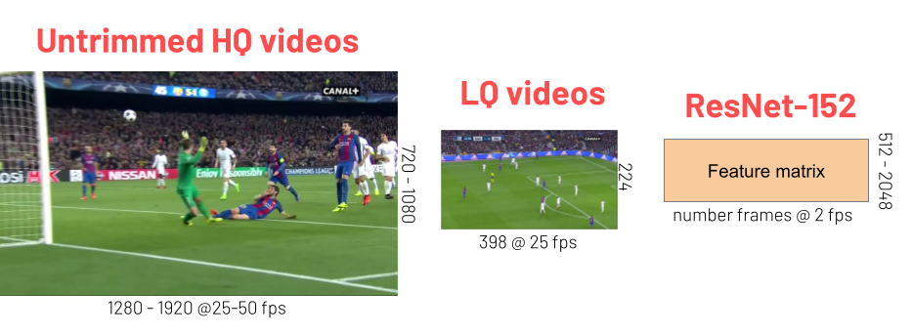
illustration for dataset structure and components.

Slide 19
Dataset Characteristics and Challenges
The SoccerNet dataset presented several unique challenges that influenced our approach:
• Ball Detection Complexity: Small boundary boxes and infrequent ball appearances in frames
• Player Occlusion: Frequent overlapping of players affecting tracking consistency 37
• Broadcast Variations: Multiple camera angles, lighting conditions, and video quality variations
• Temporal Consistency: Need for robust tracking across frame sequences with rapid movements

Slide 20
03
System Architecture

Slide 21
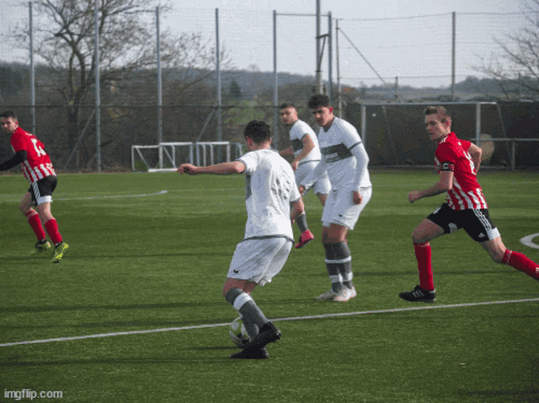
Input
Video
Detection
Tracking
Clustering
Field
Transformation
Output
Video Visualization
Possession Calculation

Slide 22
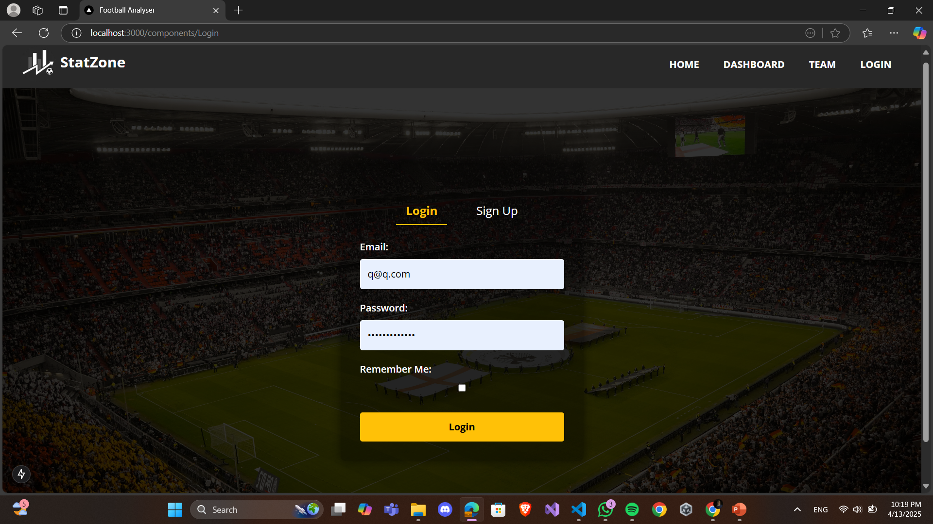
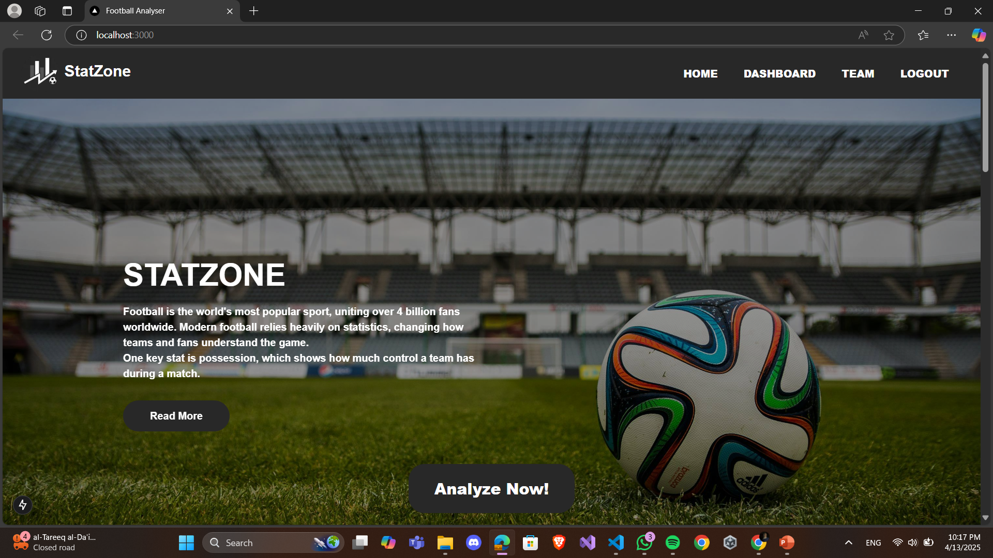
Front-End
Built with React with Next.js.
Built a modern, server-side rendered (SSR) and statically generated (SSG) web application.
Handled API communication for smooth integration with the FastAPI backend

Slide 23
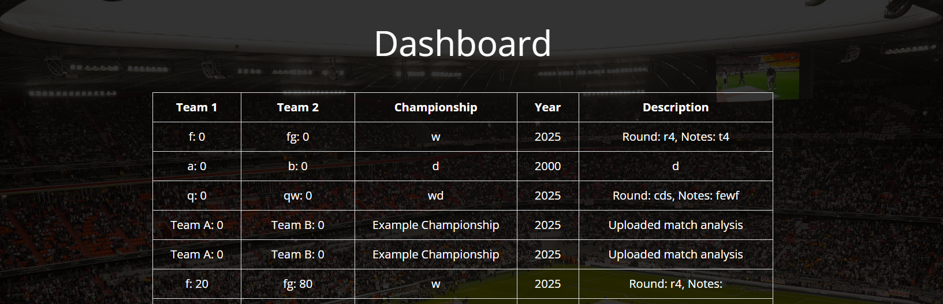
Offers history for Analyzing videos so user can go back to previously analyzed videos

Slide 24
Back-End
Developed FastAPI (Python)
Developed lightweight, high-performance RESTful APIs. Applied SOLID principles for clean, maintainable, and scalable backend services.
Applied SOLID principles for clean, maintainable, and scalable backend services.
Design Patterns & Practices:
Repository Pattern:
Abstracted and organized data access logic, improving testability and maintainability.
Dependency Injection:
Promoted loosely coupled, flexible, and easily testable components.

Slide 25
Project Strengths:
Clear, scalable separation between frontend and backend responsibilities.
Fast, modern, and SEO-friendly user experience with Next.js.
Clean, scalable, and maintainable codebase following design patterns and best practices.

Slide 26
Detection

Slide 27
Detection Strategy
Our primary goal was to accurately detect ball boundary boxes and players in the dataset.
Model Selection
We experimented with multiple YOLO (You Only Look Once) versions:
YOLOv7
YOLOv7x
YOLO11m
YOLO11l
YOLO8n
YOLOv8m
Final Choice: YOLO8
YOLO8m has the highest overall accuracy, it excelled at detecting the ball, which:
Has a small boundary box
Appears infrequently in our dataset
This made YOLO8 the most effective for our specific needs.

Slide 28
The Science Behind YOLOv8
YOLOv8 (You Only Look Once v8) is a cutting-edge object detection model developed by Ultralytics. It builds on the YOLO family with major improvements in architecture and performance.
Key Features:
Anchor-Free Detection: Unlike previous versions, YOLOv8 uses anchor-free head architecture, simplifying training and improving speed.
CSPDarknet Backbone: A lightweight and efficient backbone that extracts features at multiple scales for better detection of small and large objects.
Decoupled Head: YOLOv8 separates classification and localization branches, allowing the model to better specialize and reduce confusion between tasks.
Loss Function Enhancements:
Uses Complete IoU (CIoU) loss for more accurate bounding box regression.
Improved classification and objectness loss balancing.

Slide 29
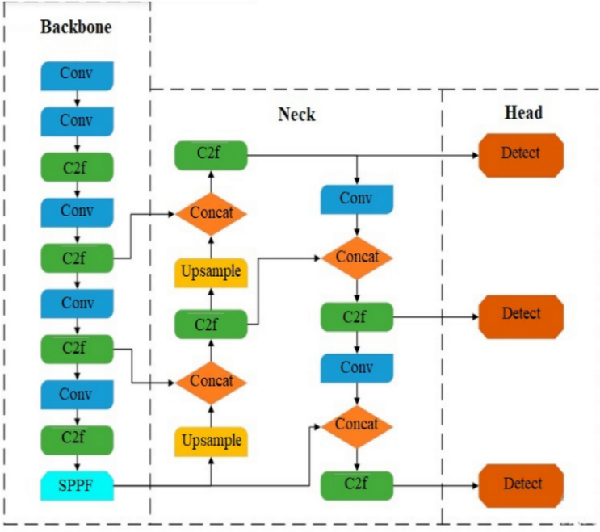
YOLOv8 architecture

Slide 30
Hyperparameter Tuning
To optimize performance, we fine-tuned key hyperparameters:
Initial learning rate (lr0)
Final learning rate factor(lrf)
Momentum
Weight decay
These adjustments were crucial for improving detection—especially for the small, fast-moving ball.

Slide 31
Tracking

Slide 32
Initial Approach – DeepSORT
Why DeepSORT?
Initially chosen for its robust multi-object tracking capabilities.
Performance Insights
Players: Worked well in tracking player movements across frames, handling their trajectories and interactions effectively.
Ball: Struggled significantly due to:
High-speed movement of the ball.
Frequent occlusions caused by players.
Difficulty in maintaining consistent identification

Slide 33
Transition to Norfair
What is Norfair?
Open-Source Library: Developed by Tryolabs for multi-object
Key Use Case: Designed to add tracking to any object detector, making it well-suited
for offline sports video analysis
Features:
Lightweight and flexible.
Tracks objects across frames using outputs from detectors like YOLOv8
Why Norfair?
Handles Complex Scenarios: Tracks multiple objects effectively, even with moving cameras and occlusions.
Customizable Metrics: Allows precise association of detections with custom-defined distance functions.
Offered greater flexibility and customization compared to DeepSORT.

Slide 34
How We Used Norfair in Our Project
Implementation Overview
Integration: Used YOLOv8 for detection; Norfair created smooth tracks.
Two Custom Models: 1. Player Tracking: Tuned for slower, predictable movements. 2. Ball Tracking: Adjusted for fast, erratic movements with stricter thresholds
Techniques Used
Custom Distance Metrics: Used Euclidean distance to associate objects between frames. Optimized to match players and the ball accurately.
Re-identification (ReID): Re-associated objects after occlusions.
Kalman Filter: Predicted positions to handle occlusions and reduce jitter.

Slide 35
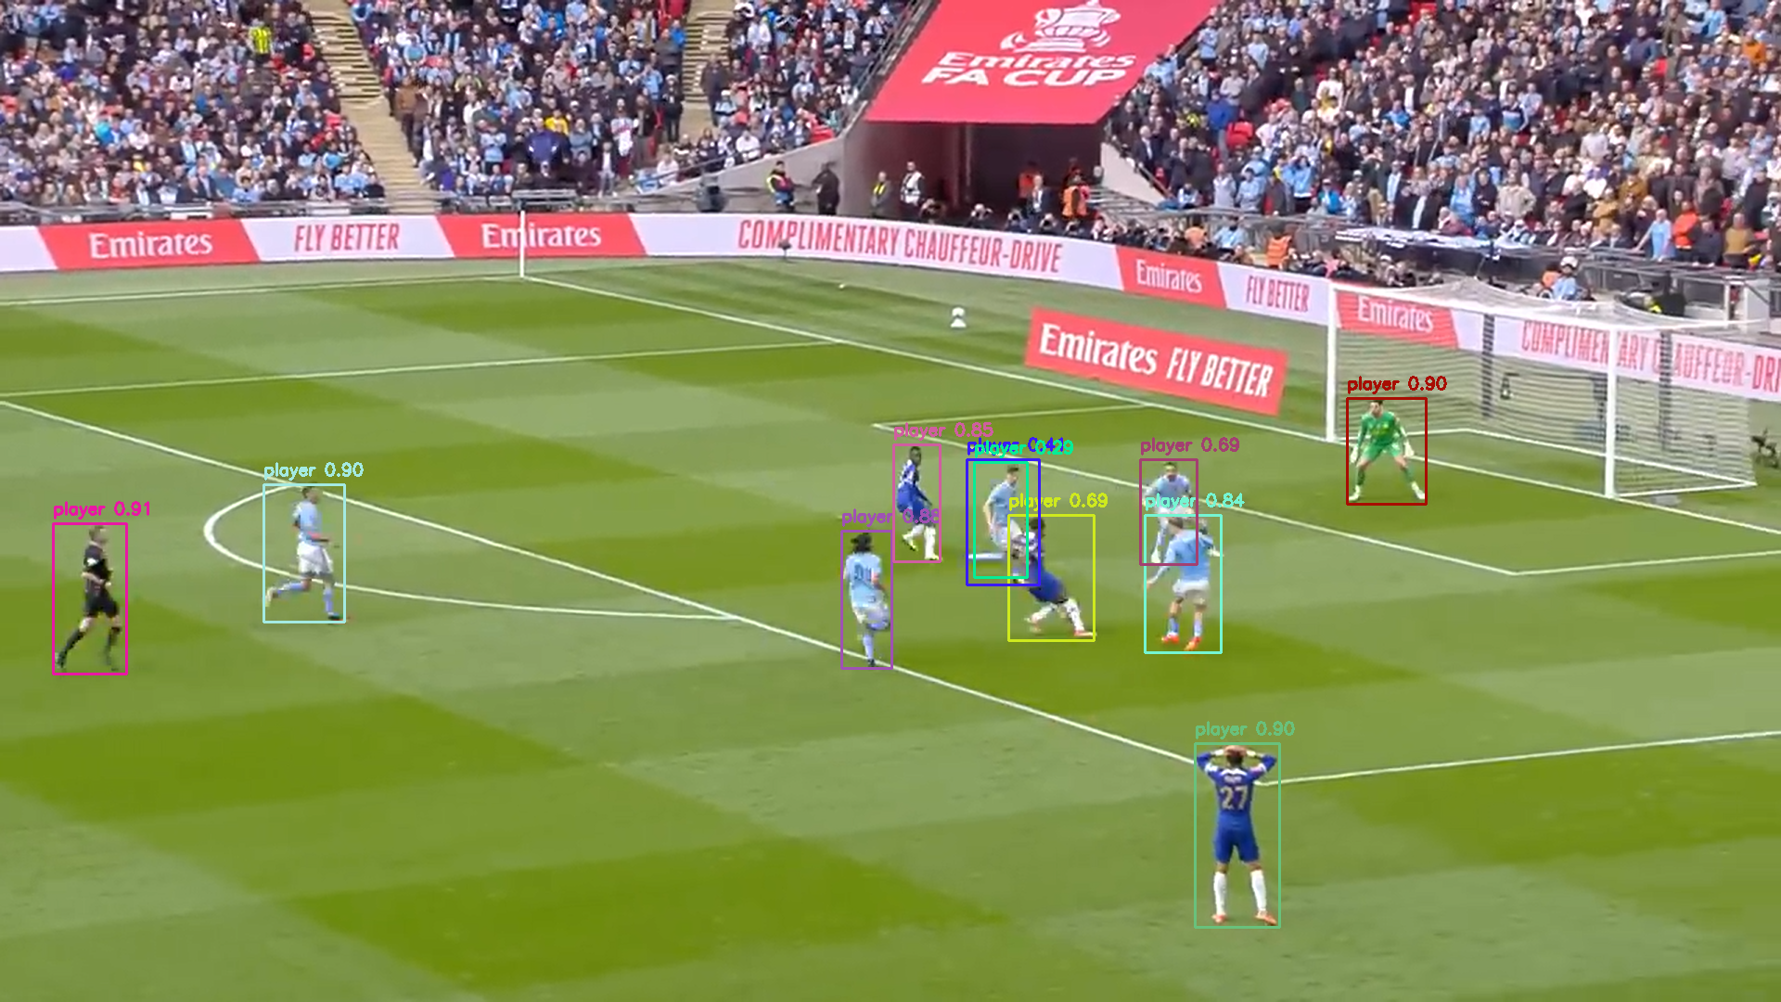
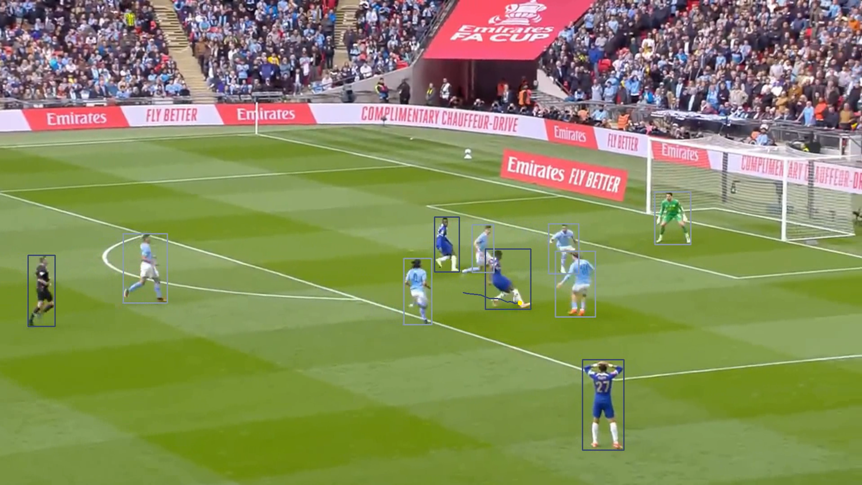
Benefits
Reliable tracking for both players and the ball.
Improved accuracy and consistency, enabling detailed game analysis.
YOLOV8 Detection output
Norfair Tracking output

Slide 36
Cluster

Slide 37
Clustering Architecture for Team Identification
Automatically group players into their respective teams using jersey colors—no manual setup required. This allows the system to adapt to different matches with varying uniforms.
Feature Extraction
Extract visual features from detected players in each frame.
Focus on dominant jersey colors.
Remove green field pixels via masking.
Use MiniBatchKMeans to find dominant non-green colors.
Convert dominant colors into flattened feature vectors.

Slide 38
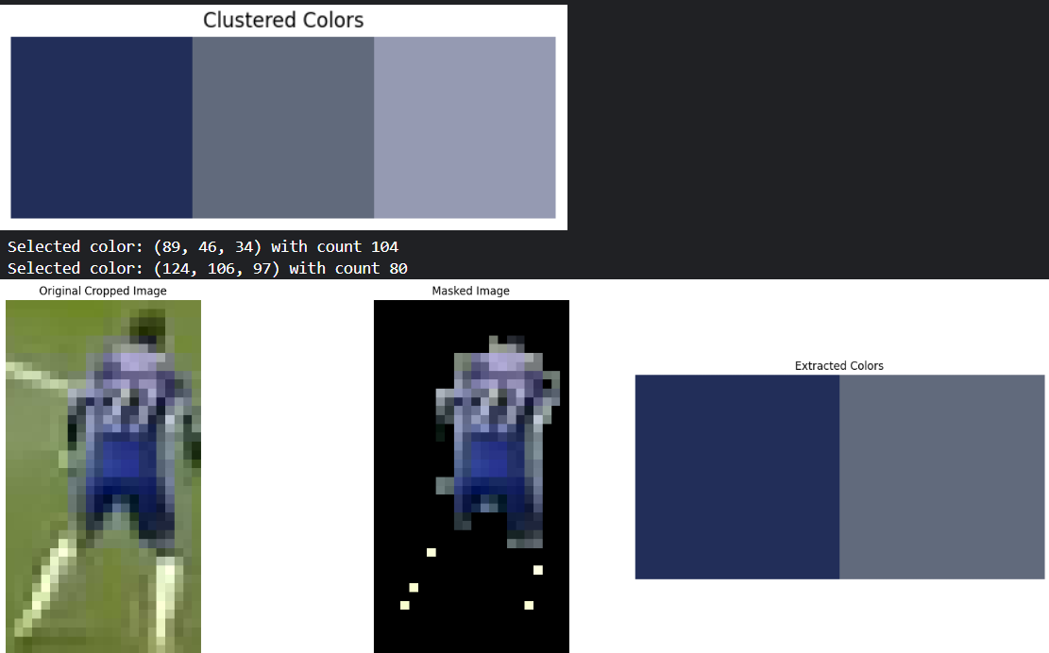
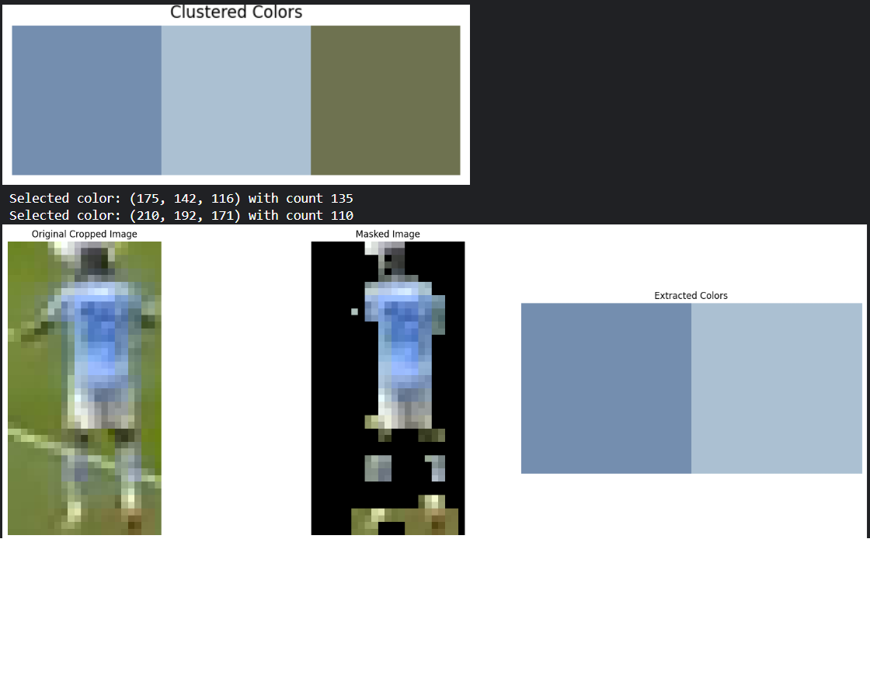
Removing Green Field Pixels
Use HSV masking to remove green field areas.
Apply morphological operations (e.g., erosion, dilation) to clean the mask.
Ensures only jersey colors are clustered

Slide 39
Multi-Frame Clustering
Single-frame analysis is unreliable (lighting, angles, overlaps).
Aggregate features over several frames for better accuracy.
Captures a stable visual representation of each player.
To handle the heavy computation:
Parallel processing using ThreadPoolExecutor accelerated color extraction and clustering.
• Visualization tools were built using OpenCV and Matplotlib to:
Display original and masked frames
Show extracted dominant colors
Assist in debugging and evaluation

Slide 40
Refining Team Colors for Visualization
Match extracted colors to predefined official team jersey colors (e.g., home, away kits).
Use a custom color distance function:
RGB Distance: Euclidean distance in RGB space.
HSV Distance: Emphasizes perceptual differences, especially in hue.
Replace extracted color with the closest official match for consistent visualization in video output.

Slide 41
Clustering Algorithm
Apply clustering to group players into two teams.
Based on the similarity of color features.
Needs to handle:
Color variations between kits.
Potential overlaps or similarities.
Outputs: Assigns each tracked player to a team.
Team Representation
Compute a representative color (e.g., cluster centroid) for each team.
Used throughout the system for:
Possession tracking
Bounding box coloring
Team consistency across frames

Slide 42
Field Transformation

Slide 43
Field Transformation in Sports Analytics
To convert player and ball positions from video frames into real-world field coordinates, we built a pipeline using camera calibration and homography estimation.
Transformation Pipeline
1️⃣ Camera Calibration
Used a custom CameraCalibrator pipeline
Loaded pre-trained keypoint and line detection models
Estimated intrinsic & extrinsic camera parameters from a single frame
Output: Projection matrix (P)
2️⃣ Homography Computation
Extracted homography matrix (H) from the projection matrix
H: Maps image coordinates → field coordinates
H⁻¹ (Inverse): Converts detected image points to real-world positions

Slide 44
3️⃣ Coordinate Transformation
For each detected object (player or ball), per frame:
Calculated the bottom-center of its bounding box
Applied H⁻¹ to map to field coordinates
Adjusted with a field offset to align with actual dimensions
4️⃣ Result Structuring
Aggregated all transformed positions
Structured output in JSON format:
Player field coordinates
Ball field coordinates
Organized per frame

Slide 45
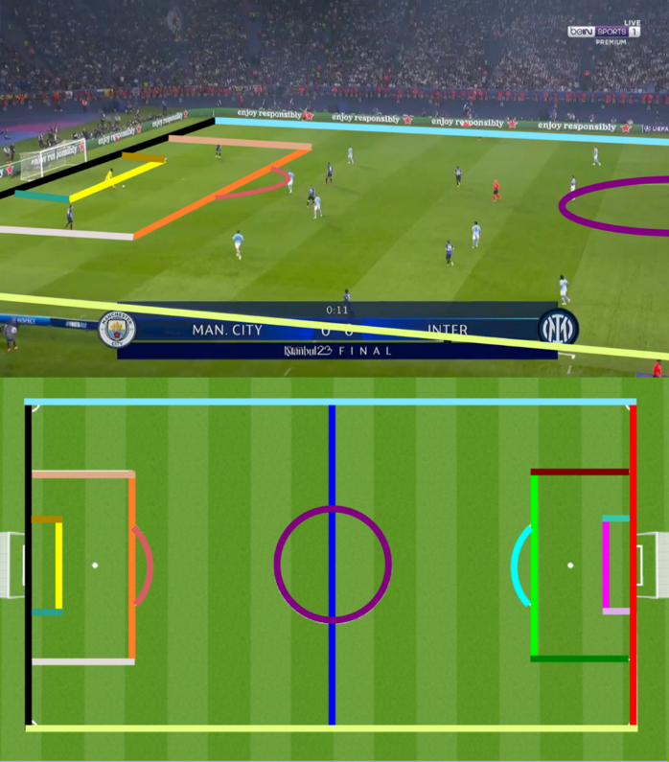
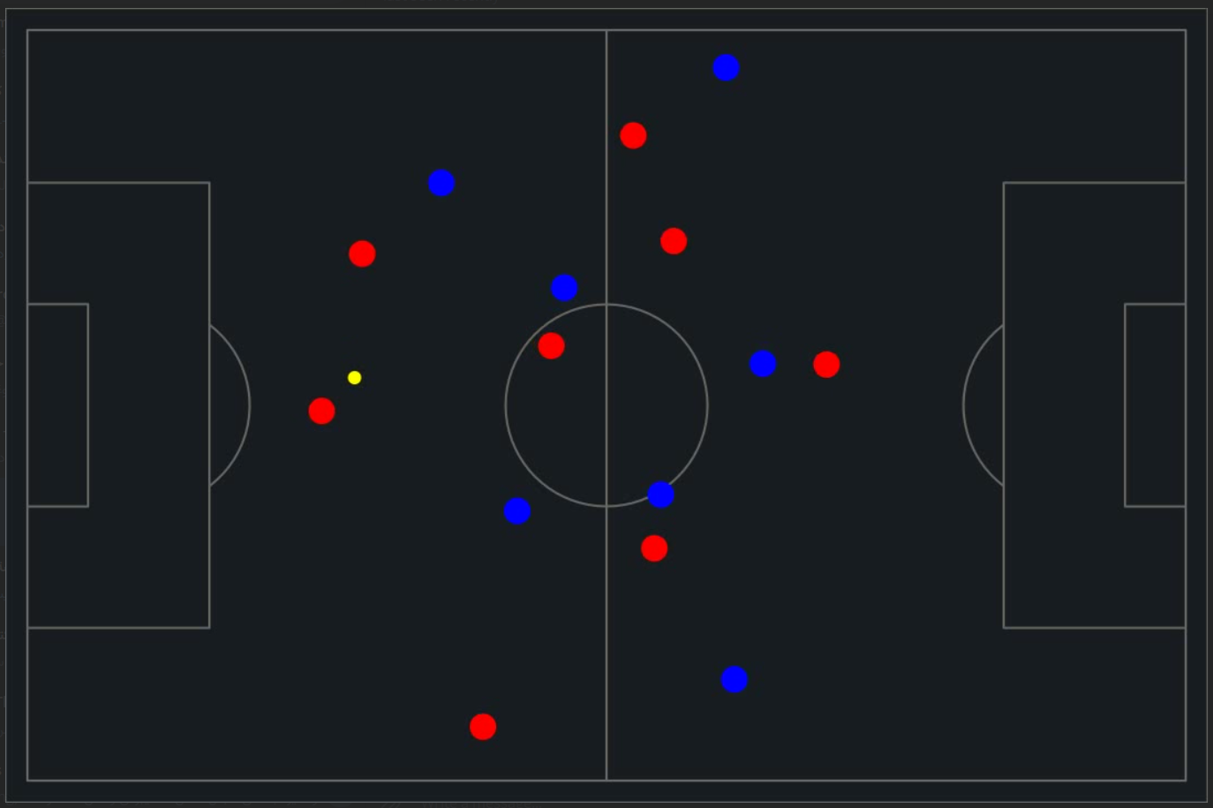

Slide 46
Ball Calculation

Slide 47
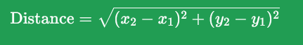
⚽ Ball Possession Tracking Logic
A step-by-step breakdown of how we determine team possession in each frame:
Step 1: Process Ball Position
If multiple detections: ➤ Choose the ball position closest to the previous frame’s position
If no detection: ➤ Use the last known valid position
📏 Step 2: Calculate Distances
For each player, calculate distance to the ball using the Euclidean distance formula:

Slide 48
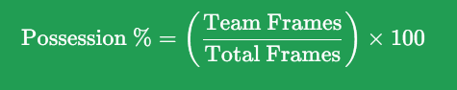
Step 3: Determine Possession
Find the closest player to the ball from each team
Possession is assigned to the team with the shorter distance
📊 Step 4: Track Cumulative Possession
Update possession frame counters:
➤ framesT1, framesT2
Calculate possession percentages:

Slide 49
04
Experimental Results

Slide 50
Robust & Real-Time Ball Possession Analysis
Technologies Used:
YOLOv8 (Detection) + Norfair (Tracking) Field & Team Classification Techniques
Field & Team Classification Techniques:
Field Homography: Maps detections to standardized pitch coordinates.
Team Clustering: Uses MiniBatchKMeans and color-matching for jersey-based team identification.

Slide 51
Robust & Real-Time Ball Possession Analysis
Evaluation:
Validation Dataset:
Tested on 19 real matches with ground-truth data for ball trajectories, player positions, and team labels.
Includes diverse lighting conditions, stadium types, and broadcast qualities.
Team Classification Accuracy:
The team classification module achieved an overall accuracy of 86% in identifying player teams based on jersey color.
This result encompasses both field players and goalkeepers, ensuring comprehensive coverage across on-pitch roles.

Slide 52
Robust & Real-Time Ball Possession Analysis
Challenges:
Jerseys with colors close to the background (e.g., yellow/green) may blend with the grass or lighting, affecting classification reliability in some frames.
Despite this, the module generalizes well across most team colors, providing consistent results under standard conditions.
Performance Metrics:
Mean Squared Error (MSE): 6.92
Mean Absolute Error (MAE): 2.28%
Max Absolute Error: 5.0%
Outcome:
Accurate and reliable possession estimation: Suitable for real-world football analytics.
Practical Deployment: Tested in match scenarios, providing actionable insights for coaches and analysts

Slide 53
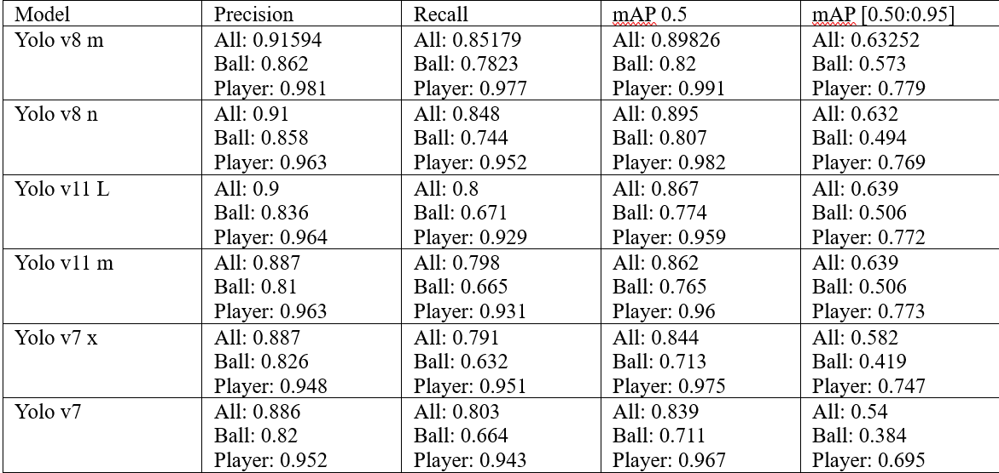
YOLO Evaluation

Slide 54
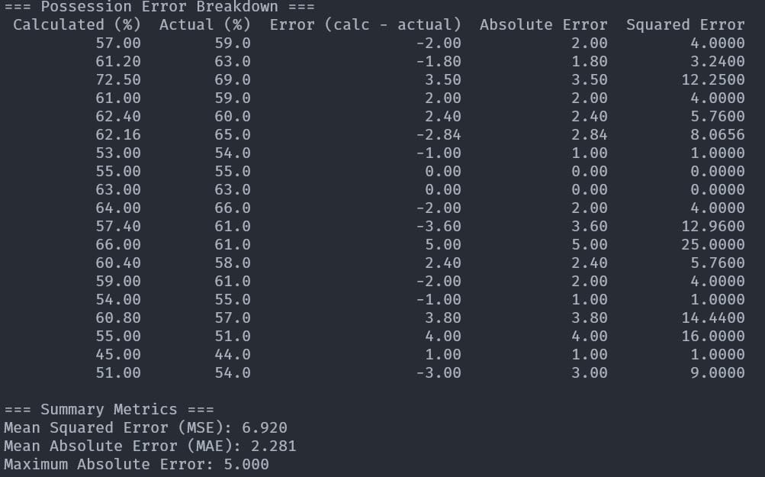

Slide 55
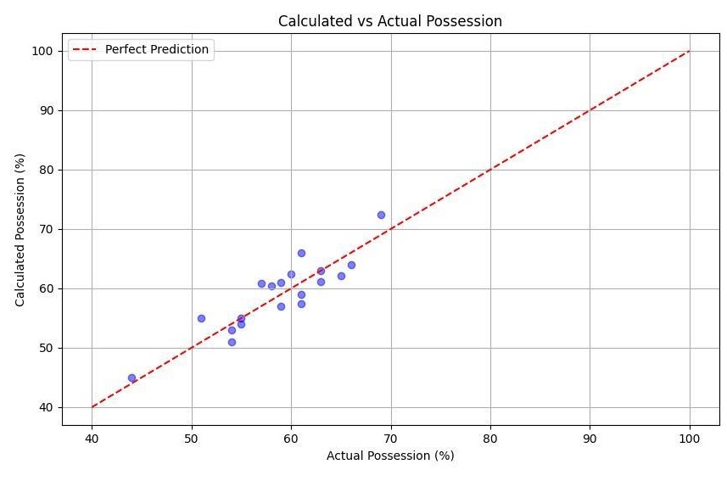
Actual possession vs predicted possession

Slide 56
05
Demo

Slide 57
06
Conclusion and future work

Slide 58
Football Ball Possession Tracking System
Combines Deep Learning + Computer Vision
Key Features:
Detects players & ball in each video frame
Classifies players into teams using CNNs
Estimates ball proximity over time
Applies context-aware temporal analysis to classify possession→ Team A, Team B, or Contested
Performance:
91.2% Average Precision
4.1% Mean Absolute Error (vs. manual annotation)
Outcome:
Integrated into a user-friendly app
Designed for coaches & analysts to evaluate match performance

Slide 59
Future Improvements & Extensions
Enhanced Ball Detection
Handle crowded & occluded scenarios more effectively
Tactical Context Analysis
Assess possession quality, danger level, and decision-making
Hardware Optimization
Make system usable on low-end devices for broader access
Advanced Match Analytics
Build-up play patterns
Transition speed
Pressing efficiency
Tool Integration
Seamless connection with existing match analysis platform

Slide 60
References

Slide 61
Radford, A., Kim, J. W., Hallacy, C., Ramesh, A., Goh, G., Agarwal, S., … & Sutskever, I. (2021). Learning transferable visual models from natural language supervision. In International Conference on Machine Learning (pp. 8748-8763). PMLR.
Ramesh, A., Pavlov, M., Goh, G., Gray, S., Voss, C., Radford, A., … & Sutskever, I. (2021). Zero-shot text-to-image generation. In International Conference on Machine Learning (pp. 8821-8831). PMLR.
Ramesh, A., Dhariwal, P., Nichol, A., Chu, C., & Chen, M. (2022). Hierarchical text-conditional image generation with CLIP latents. arXiv preprint arXiv:2204.06125.
Ramesh, A., Dhariwal, P., Nichol, A., Chu, C., & Chen, M. (2022). Hierarchical text-conditional image generation with CLIP latents. arXiv preprint arXiv:2204.06125.
Yang, Z., Li, L., Wang, J., Lin, K., Azarnasab, E., Ahmed, F., … & Wang, L. (2023). MM-REACT: Prompting ChatGPT for multimodal reasoning and action. arXiv preprint arXiv:2303.11381.
Zhu, D., Chen, J., Haydarov, K., Shen, X., Zhang, W., & Elhoseiny, M. (2023). ChatGPT asks, BLIP-2 answers: Automatic questioning towards enriched visual descriptions. arXiv preprint arXiv:2303.06594.

Slide 62
7. Lu, J., Batra, D., Parikh, D., & Lee, S. (2019). ViLBERT: Pretraining task-agnostic visiolinguistic representations for vision-and-language tasks. Advances in Neural Information Processing Systems, 32.
8. Tan, H., & Bansal, M. (2019). LXMERT: Learning cross-modality encoder representations from transformers. In Proceedings of the 2019 Conference on Empirical Methods in Natural Language Processing and the 9th International Joint Conference on Natural Language Processing (pp. 5100-5111).
9. Qi, D., Su, L., Song, J., Cui, E., Bharti, T., & Sacheti, A. (2020). ImageBERT: Cross-modal pre-training with large-scale weak-supervised image-text data. arXiv preprint arXiv:2001.07966
10. Cho, J., Lei, J., Tan, H., & Bansal, M. (2021). Unifying vision-and-language tasks via text generation. In International Conference on Machine Learning (pp. 1931-1942). PMLR.
11. Zheng, Y., Chen, Z., Huang, D., Xu, J., & Xu, H. (2022). MMCHAT: Multi-modal chat dataset on social media. arXiv preprint arXiv:2108.07154.
12. Giancola, S., Amine, M., Dghaily, T., & Ghanem, B. (2018). SoccerNet: A scalable dataset for action spotting in soccer

Slide 63
13. videos. In Proceedings of the IEEE conference on computer vision and pattern recognition workshops (pp. 1711-1721).
14. Deliège, A., Cioppa, A., Giancola, S., Seikavandi, M. J., Dueholm, J. V., Nasrollahi, K., ... & Van Droogenbroeck, M. (2021). SoccerNet-v2: A dataset and benchmarks for holistic understanding of broadcast soccer videos. In Proceedings of the IEEE/CVF Conference on Computer Vision and Pattern Recognition (pp. 4508-4519)
15. Cioppa, A., Deliège, A., Magera, F., Giancola, S., Barnich, O., Ghanem, B., & Van Droogenbroeck, M. (2022). Scaling up SoccerNet with multi-view spatial localization and re-identification. Scientific Data, 9(1), 762
16. Chen, J., Little, J. J., Hsiao, E., & Zhu, J. (2021). SportsCap: Monocular 3D human motion capture and fine-grained understanding in challenging sports videos. International Journal of Computer Vision, 129(10), 2846-2864.
17. Vats, K., Fani, M., Walters, P., Clausi, D. A., & Zelek, J. (2021). Player tracking and identification in ice hockey. Expert Systems with Applications, 173, 114630.
18. Cuevas, C., Quilón, D., & García, N. (2020). Techniques and applications for soccer video analysis: A survey. Multimedia

Slide 64
Thank You!
Any Questions?

